Slide 1
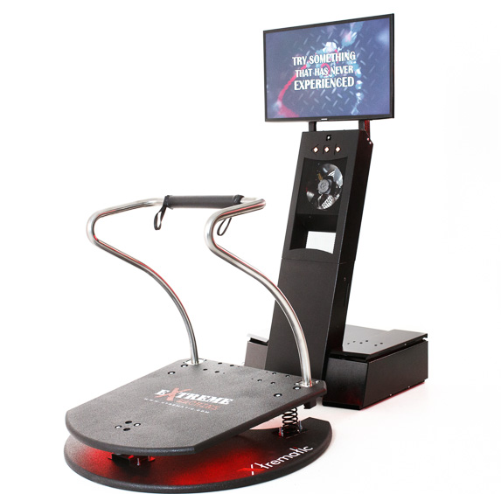
Virtual Reality Dynamic Simulator "Extreme-machine"
Mobile: +375296936999
Email: info@xtrematic.com
Site: www.xtrematic.com

Slide 2
Our achievements will tell about us better …
7 representatives worldwide
Permanent participation in international exhibitions
More than 100 successful
deals
The product was awarded
4 times
Satisfied customers become partners
We work with
foreign
clients

Slide 3
What is "Extreme-machine"?
"Extreme-machine" is a simulator of extreme experiences
It works with a virtual headset and allows the user to see 360° in virtual space
The platform responds to the position of the body in space and the user can control the game
Unique video content is available under license
A full presence effect is achieved by a high-quality video and realistic graphics and by additional effects (vibration, powerful sound, wind effect)

Slide 4
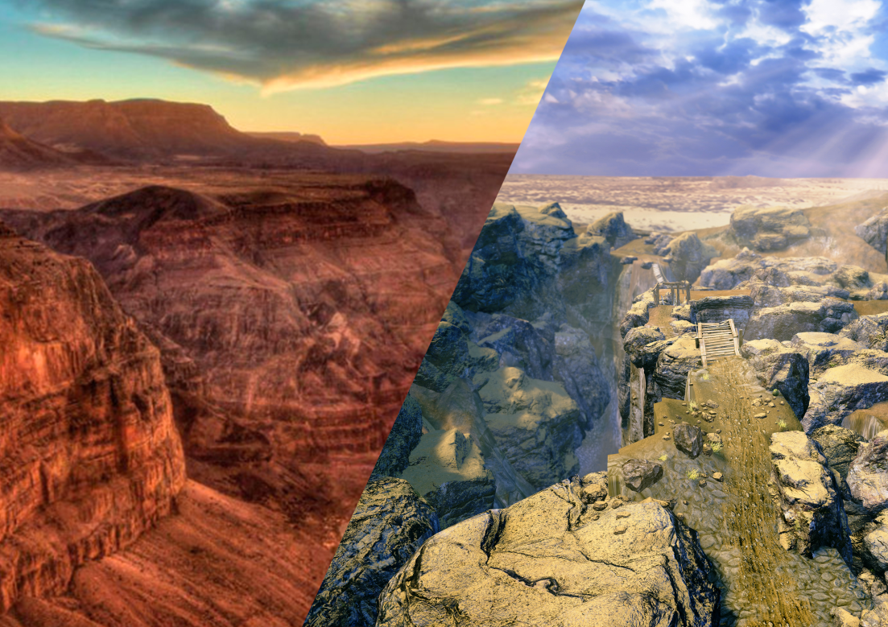
"Extreme-machine" is a possibility:
To visit places you’ve never been to
To experience what you’ve never experienced
Target audience varies from children, teenagers and young people to adults of any age
"Xtrematic" was the first who made a full interactive virtual rides
The graphics quality is striking. A full immersion in virtual reality!
Virtual Reality VS Reality

Slide 5
Quick business start with "Extreme-machine"
• Quick return on investment (4-6 month)
• 1 year warranty and 24 hours
technical support
• Required certificates
• Delivery from 3 to 10 days and the installation in half a day
• A large film library includes 15 films for a virtual headset (our own animation studio develops unique, similar to nothing more films)
• Employee remote control
• Sending Email Reports
• Possibility to install a bill /coin acceptor (with this "Xtrematic" employees will help)

Slide 6
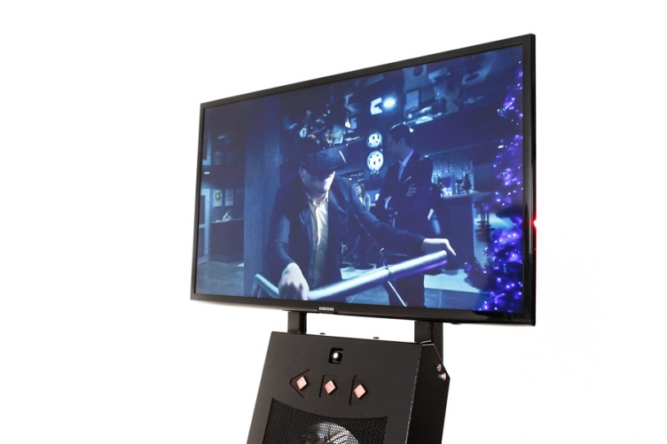
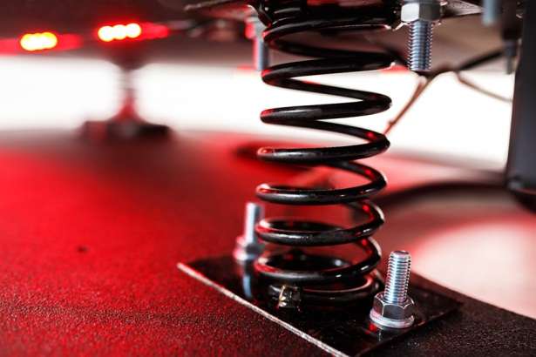
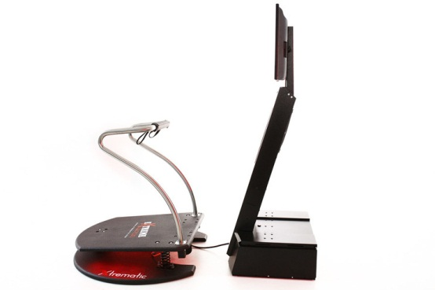
Ease of use
The simulator works on a simple 220 V power socket
It takes only 3 sq. m
Its modern and practical design will fit into any interior
The navigation is implemented just through 3 buttons
Easy and fast diagnostics of the motion simulator’s state is carried out by the native software "X-starter“
The technical support will always help to update software and download a new film
In contrast to many virtual amusement rides, working on electric drives, in the "Extreme-machine" platform there is nothing that can break.
Foreign components passed all tests on electromagnetic compatibility and on the safety of low voltage equipment. On these test responds conformity certificates of any country are given

Slide 7
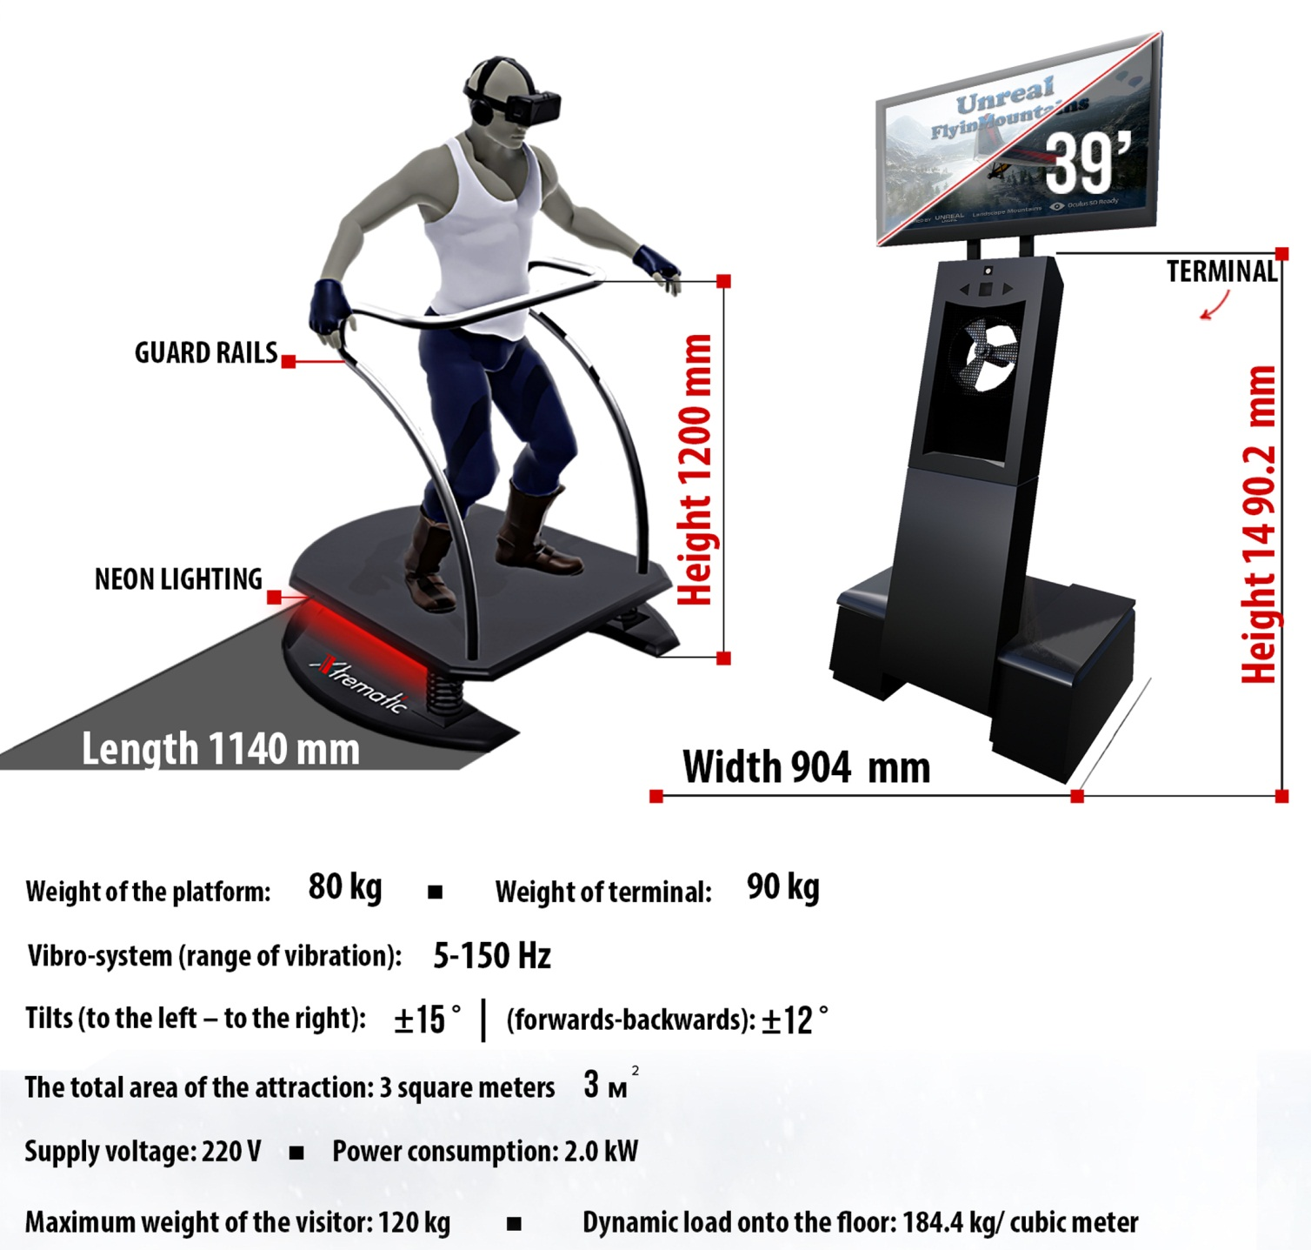
Technical characteristics

Slide 9
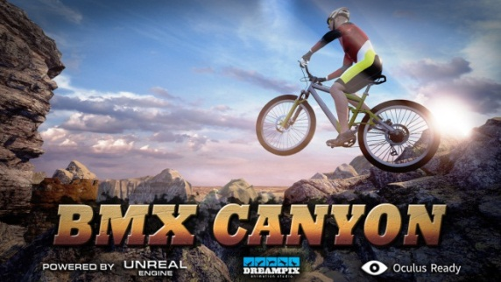
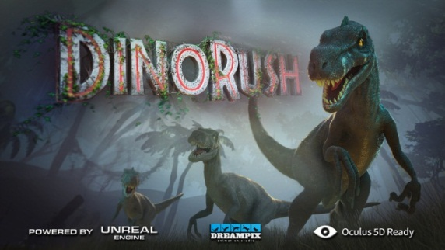
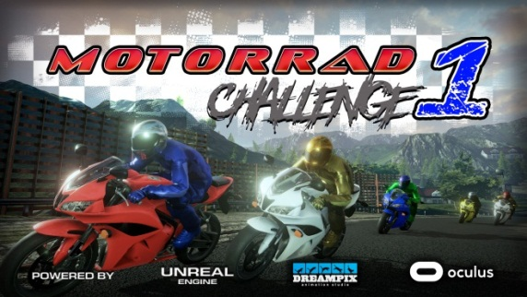
New films can be purchased additionally
In this film a player competes in a race through mountainous area. One can change the speed by changing the position of the body in space. Dynamic music and beautiful views are the particularities of the film.
This is a first film-runner in which a player can choose a direction in the game space, and run away from dangerous predators in search of an exit.
Absolute control of the process of the game, the speed, and network mode support immerse the player in the virtual space.
Legendary amusement “Bungee" is now available in virtual reality. The feeling of flight, speed and great views of Grand Canyon will make you lose your head from delight.

Slide 10
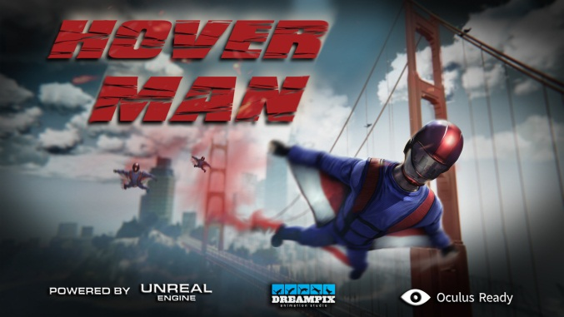
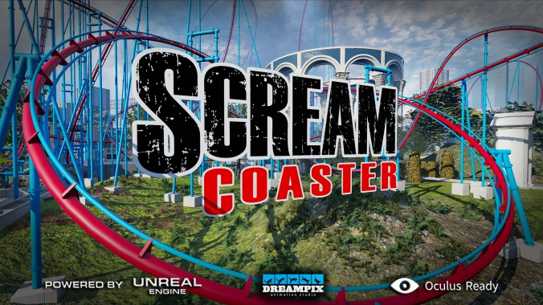
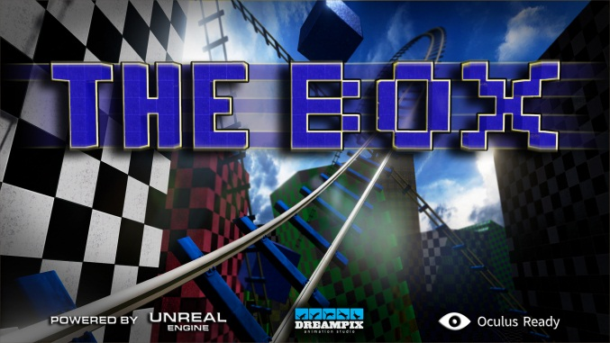
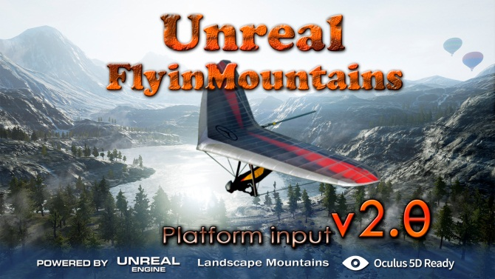
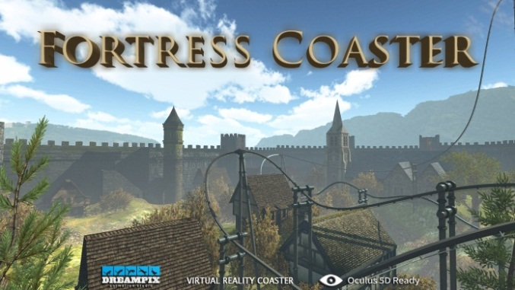
11 films in a base set with the “Extreme-machine"

Slide 11
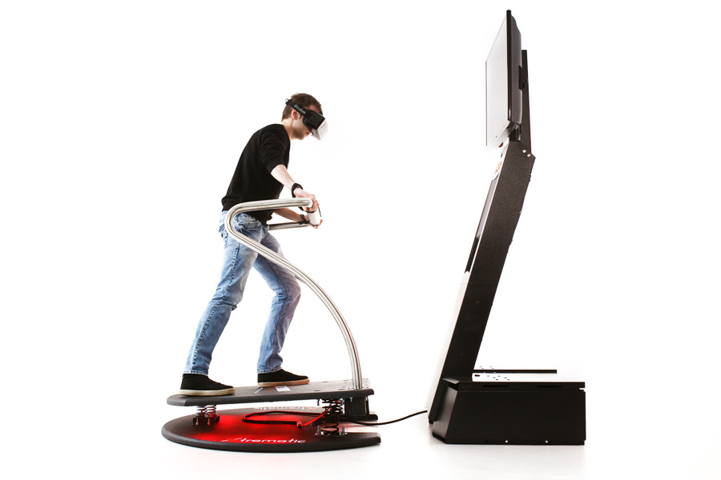
How to buy the virtual simulator "Extreme-machine"?
Contact through the form on the page "Home", by mobile +375296936999 or mail info@xtrematic.com and clarify pricing and conditions
Conclude a contract
Pay for a virtual amusement ride "Extreme-machine"

Slide 12
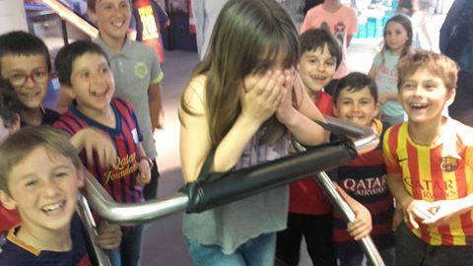
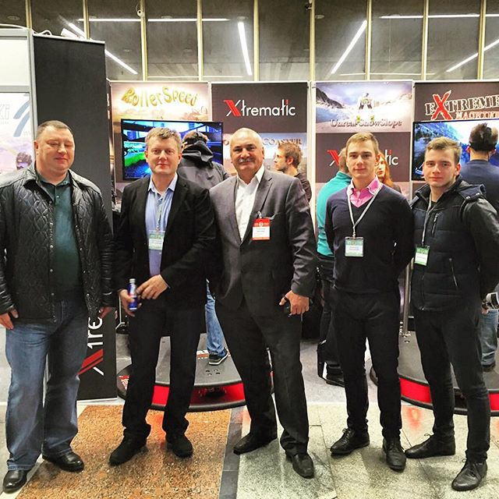
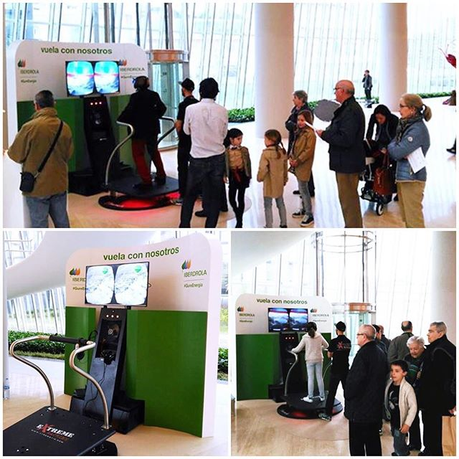
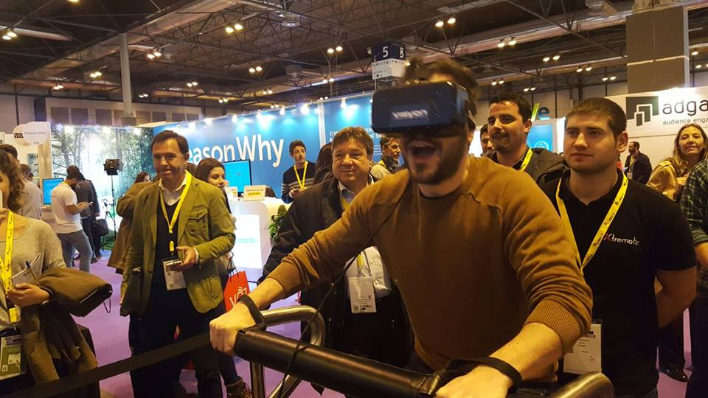
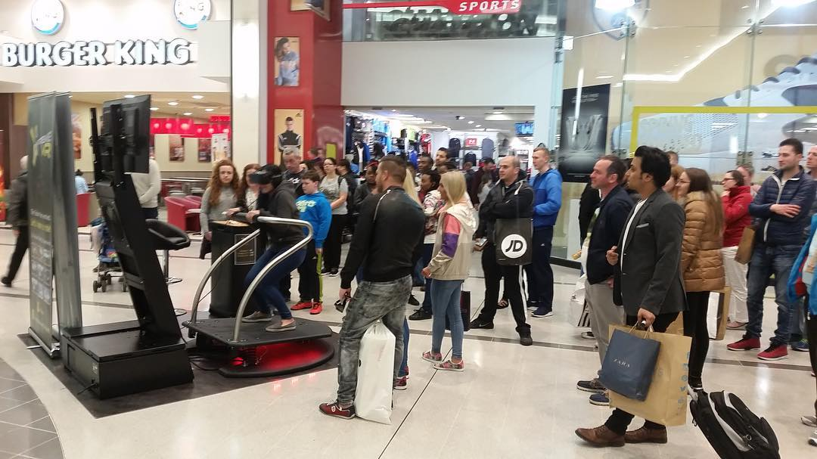
Become a part of "Xtrematic"!

